Slide 1
Scrum, scaling Scrum with Nexus & the SPS exam
Getting through it efficiently
Mario De’Cristofano

Slide 2
I want to provide for my own teams a track of sensible low-effort learning to get through the SPS exam.

Slide 3
Broadly, this is Scrum

Slide 4
Nexus adds additional rigour to Scrum to allow many Scrum teams to work effectively, integrate tightly & delivery more value.

Slide 5
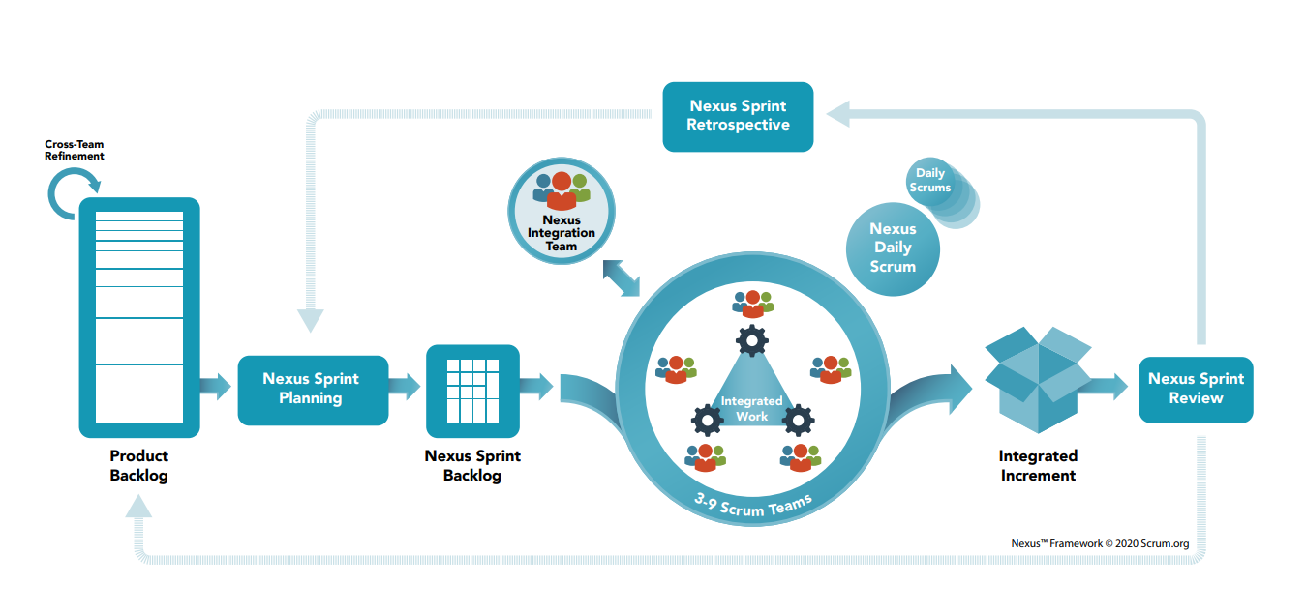
Broadly, this Nexus

Slide 6
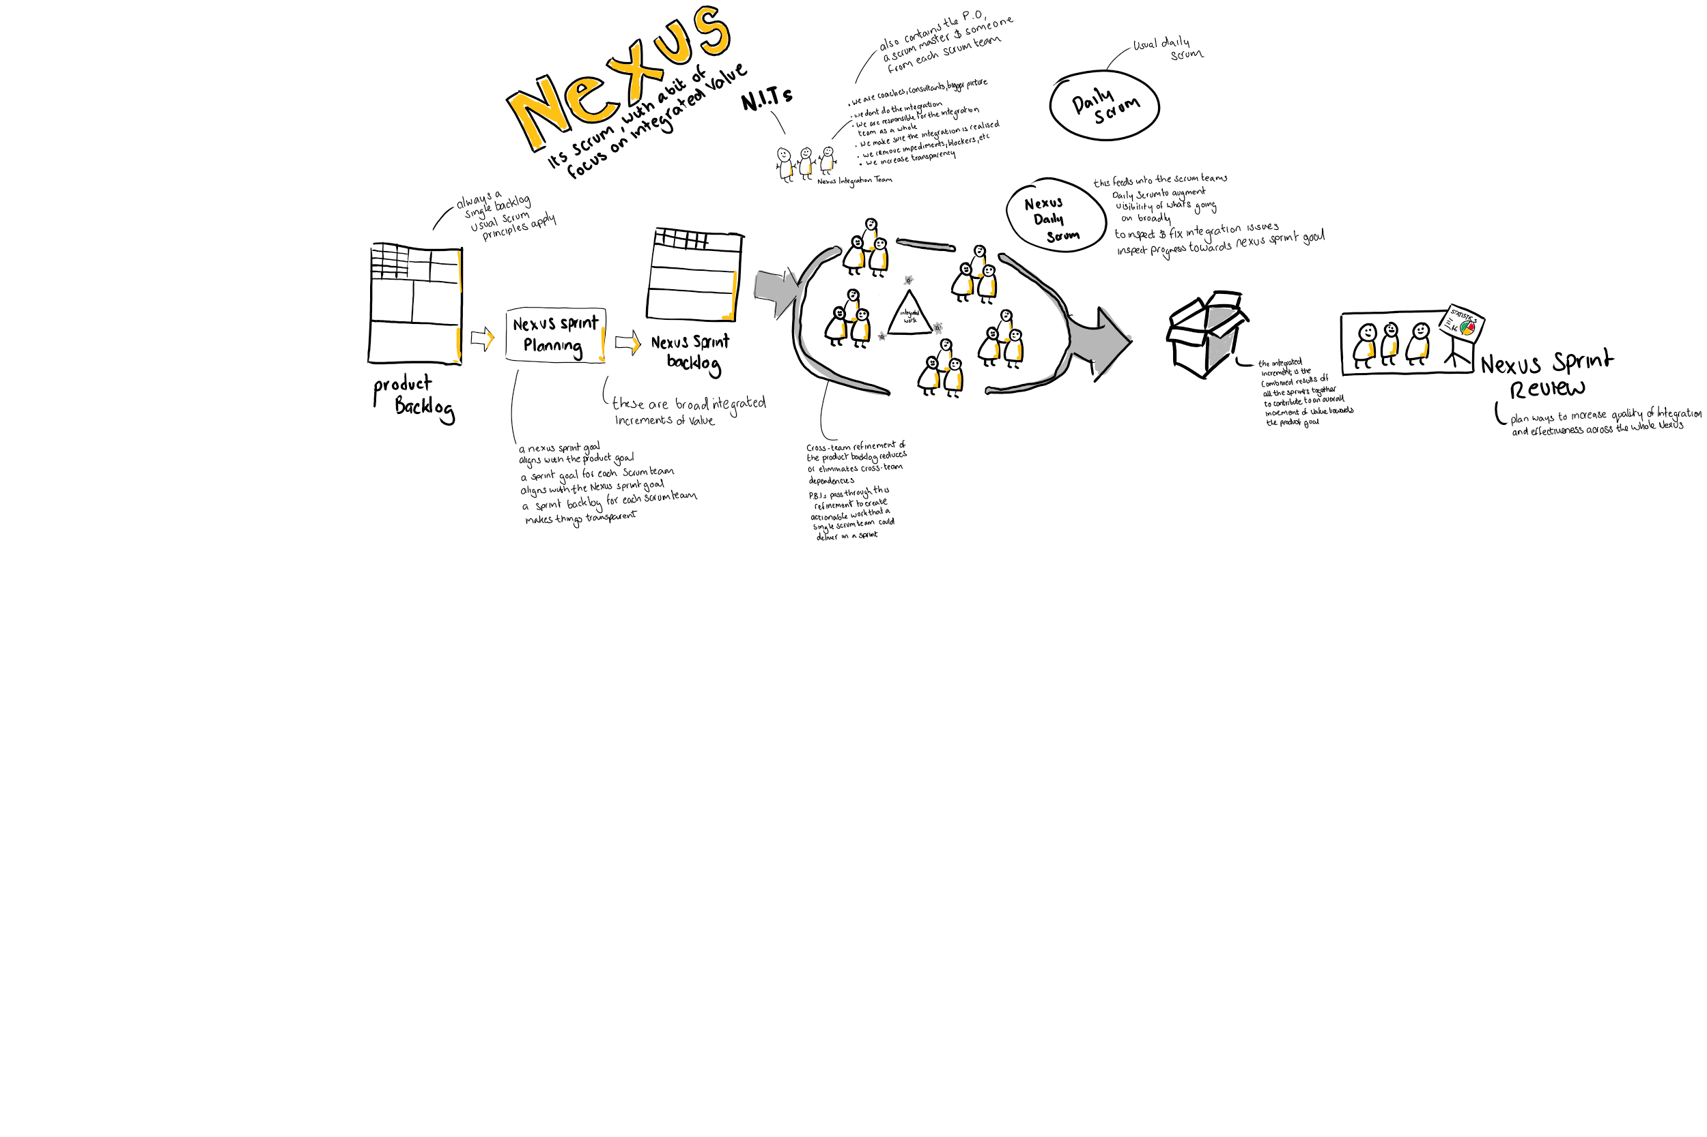
The product backlog is still the same as in Scrum. Co-ordinated & run by a Product Owner.
Tasks are prioritised & estimated in the same manner as has always been.

Slide 7
Nexus sprint planning involves thinking about the big picture.
The purpose of Nexus Sprint Planning is to coordinate the activities of all the Scrum Teams within a Nexus for a single Sprint. Appropriate representatives from each Scrum Team & the PO owner meet to plan the sprint.
The result of the Sprint Planning is;
A Nexus Sprint Goal which aligns with the product goal & describes the purpose that will be achieved during the sprint
A Sprint Goal for each scrum team that aligns with the Nexus Sprint Goal
A Single Nexus Sprint Backlog which represents the work of the Nexus toward the Nexus Sprint Goal & makes any cross-team dependencies transparent
A Sprint Backlog for each Scrum team which makes transparent the work they will do in support of the Nexus Sprint Goal
The goals of the Nexus as a whole are taken into account. Sprint goals for each scrum team should also align with the overall Nexus goal

Slide 8
Nexus Sprint
backlog
The Nexus Sprint Backlog is updated throughout the Sprint as more is learned. It should have enough detail that the Nexus can inspect their progress in the Nexus Daily Scrum.
The commitment for the Nexus Sprint Backlog is the Nexus Sprint goal.
As the Scrum teams work, they keep the Nexus Sprint goal in mind, that goal is a blended goal representing overall value, which is made up in effect, of the individual sprints.
The NIT (Nexus Integration team) keep an eye on the overall goal, the integration between the teams & any impediments that may stop that integration or move towards the Nexus Sprint goal.
A composite of the Nexus Sprint Goal & Product Backlog items from the sprint backlogs of the individual Scrum teams.

Slide 9
The Scrum & Nexus Theory
The Scrum works as any other Scrum, however the constant broader view of the big picture is kept in mind rather than the Scrum team working on it’s own sprint goals to a single end.
The NIT & additional Nexus ceremonies enables the broader view & ensures integration between each Scrum team so sprint goals are aligned to the overall Nexus goals.
The Nexus is the loose arm around the sprint teams, & the output of the Nexus represents a tightly co-ordinated piece of value towards a product/service increment.
An example would be;
Nexus Sprint Goal – Delivery of a trading platform feature of showing real time market data
Sprint goals to contribute to that could be things such as ‘fetching a live feed’ , whilst another sprint handles ‘displaying feed on small screens’ & another sprint handles ‘user interface of the feed display’ etc
At its heart, Nexus preserves & enhances Scrum’s foundational bottom-up intelligence & empiricism whilst enabling more value by integrating more teams.

Slide 10
The Nexus Sprint review & Retrospective
The sprint review held at the end of the sprint (dur) helps to provide feedback on the done integrated increment that the Nexus has built over the sprint, & determines future adaptations.
The purpose of the Nexus Sprint retrospective is to holistically look at what more can be done to improve integration, or maybe how the last sprint went or even how the individuals are formin’ stormin’ normin’ etc.

Slide 11
Ingredients for the exam

Slide 12
Read the 20 odd page Scrum guide here.

Slide 13
Then read the Nexus guide here.
This video is good, so watch this
Here.

Slide 14
Now buy this Udemy course here.

